Slide 1
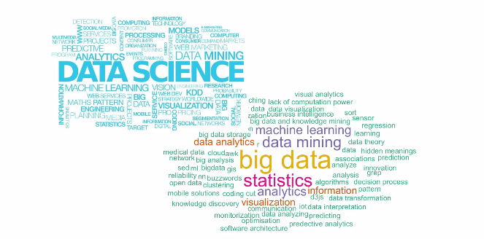
Data Science – Day 3

Slide 2
Recap
CardiacGoodfitness - Inferences

Slide 3
Data Hierarchy
Import
Wrangling
Vector (Integer vs Character)
Matrix
Data. Frame
Tibble
Array
Data. Table
List
Scalar

Slide 4
Dplyr / TidyR
stringr
lubridate
Model Basics
Lime
InsuranceData

Slide 5
Exercises

